Slide 1
MATH
Machine Learning
LAB 5
Bharuno Mahesworo

Slide 2
How to LAB?
Download this PPT
Follow the instruction
Screen shoot your code and its result of each instruction, then put it on the instruction slide.
Submit your slide deck and notebook file
Googling is permitted
Using Communication platform (email, discord, social media, etc.) is prohibited
Submit to:
bharuno.mahesworo@binus.ac.id
Before the end of the LAB.
Subject: ML_(class code)_(LAB session)_NIM
Example: ML_LZ99_LAB1_12345
File name format: ML_(class code)_(LAB session)_NIM
Example: ML_LZ99_LAB1_12345

Slide 3
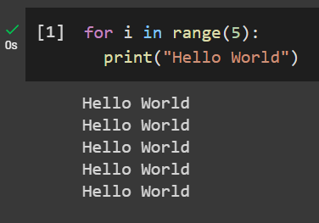
Print Hello World 5 times using loops
Example
Instruction
Your compiled codes
hint
for loops or while loops

Slide 4
LAB 5 – Unsupervised Learning - Clustering
The objective is to cluster samples. “LAB_5_1.xlsx” and “LAB_5_2.xlsx” can be downloaded from binusmaya

Slide 5
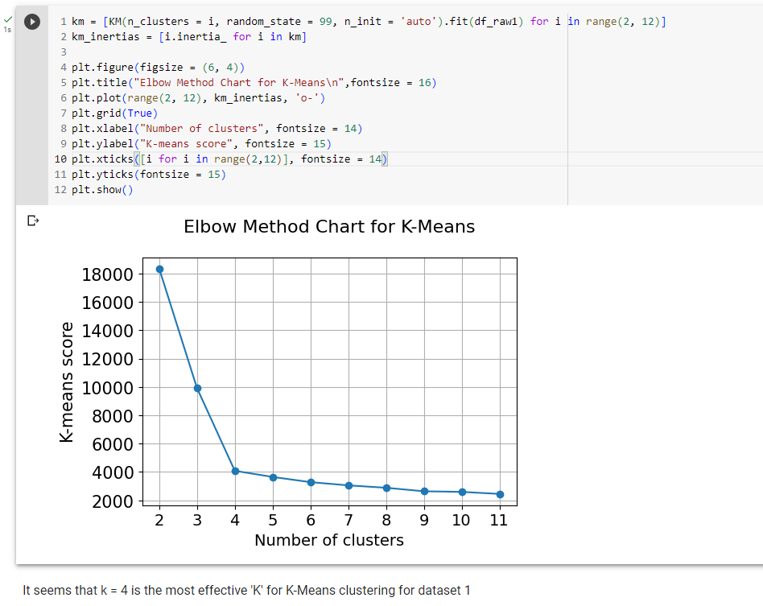
1. From dataset 1, find the most effective “K” using elbow method. Show the elbow chart!

Slide 6
2. From dataset 1, create the scatterplot using subplots with the following layout, and give color based on the predicted cluster.
Col A vs Col B | Col B vs Col C
Col C vs Col D | Col D vs A

Slide 7
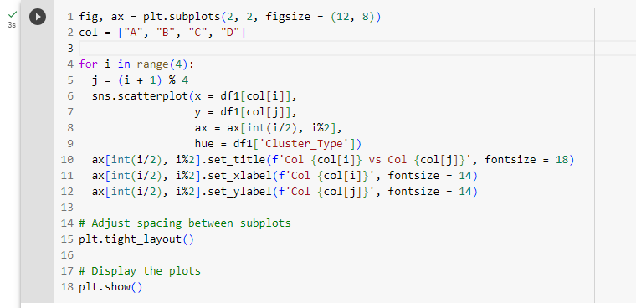
2. From dataset 1, create the scatterplot using subplots with the following layout, and give color based on the predicted cluster.

Slide 8
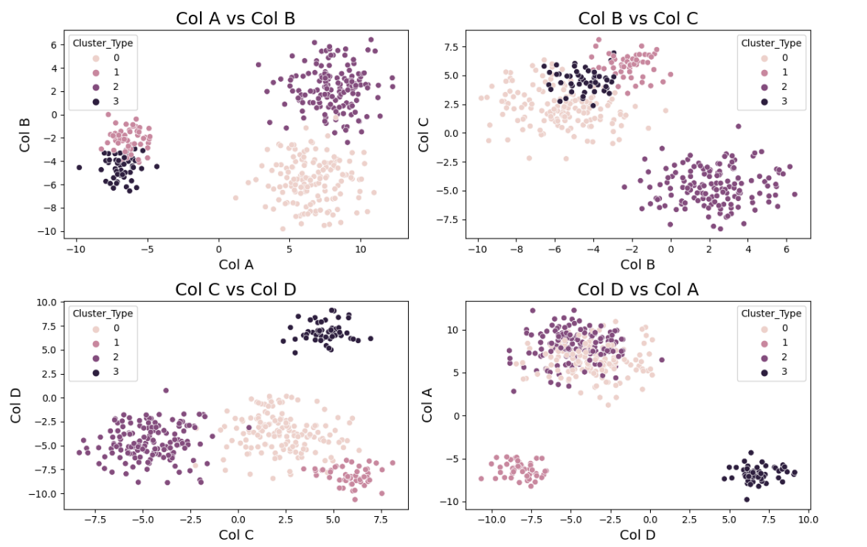
2. From dataset 1, create the scatterplot using subplots with the following layout, and give color based on the predicted cluster.

Slide 9
3. From dataset 2, create the scatterplot using subplots with the following layout, and give color based on 3 different model (5 clusters).
K-Means | Gaussian Mixture | DBSCAN

Slide 10
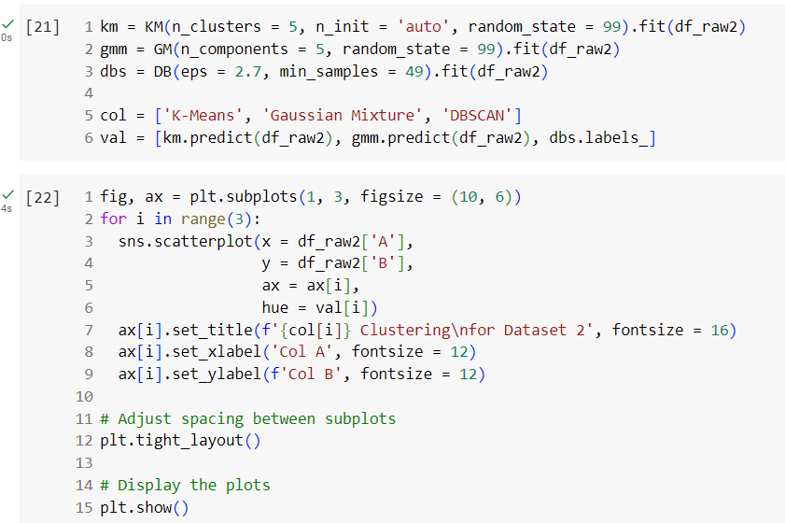
3. From dataset 2, create the scatterplot using subplots with the following layout, and give color based on 3 different model (5 clusters).

Slide 11
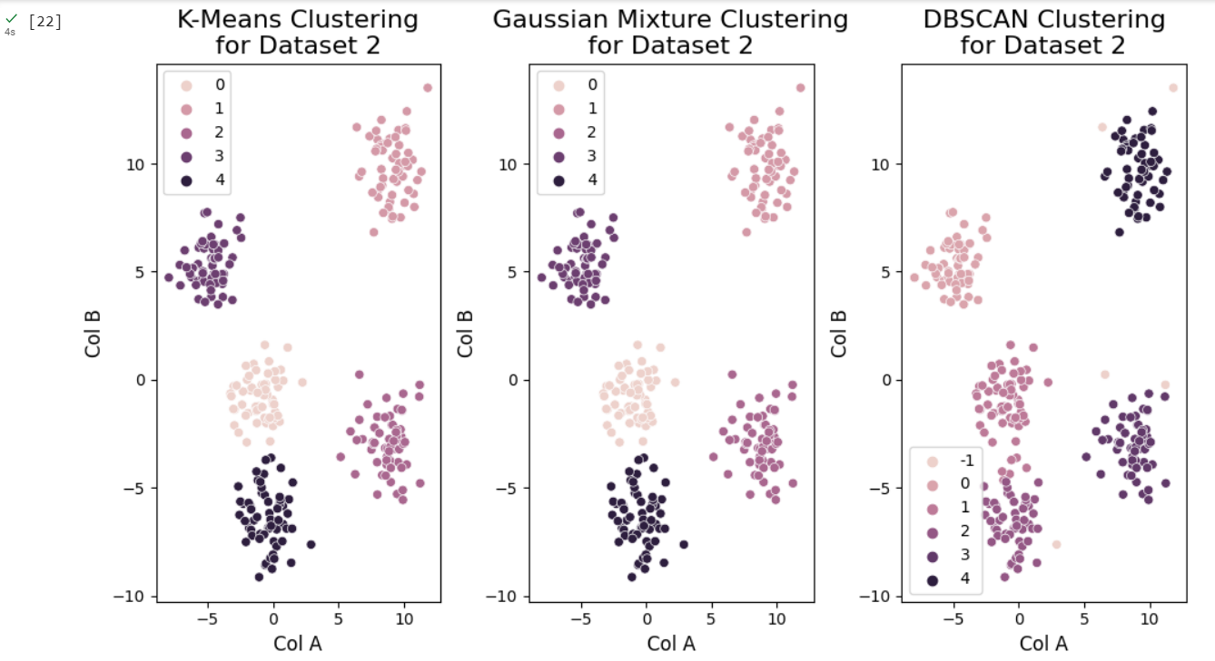
3. From dataset 2, create the scatterplot using subplots with the following layout, and give color based on 3 different model (5 clusters).

Slide 12
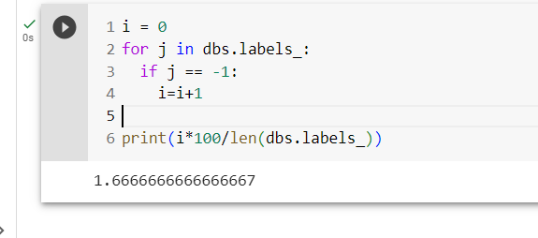
3. From dataset 2, create the scatterplot using subplots with the following layout, and give color based on 3 different model (5 clusters).

